Slide 1
Vietnam Globe program
Annual report 2019
By Dr. Vu Anh TUAN
Country Coordinator
Vietnam

Slide 2
Contents
Background information
Activities in 2018 - 2019
Future activities

Slide 3
Back ground information
2013: VNSC and Center for Education and Development organized workshop “GLOBE Program Introduction” to school teachers and students, research institutes and scientists around Hanoi;
2013 – 2015: VAST/VNSC contacted closely with NASA, Governmental Offices and Ministries of Vietnam to work on the Cooperation Agreement for GLOBE Program;
On 14 Sept 2015 VAST received the official approval of the Government of Vietnam signing Cooperation Agreement for GLOBE Program;

Slide 4
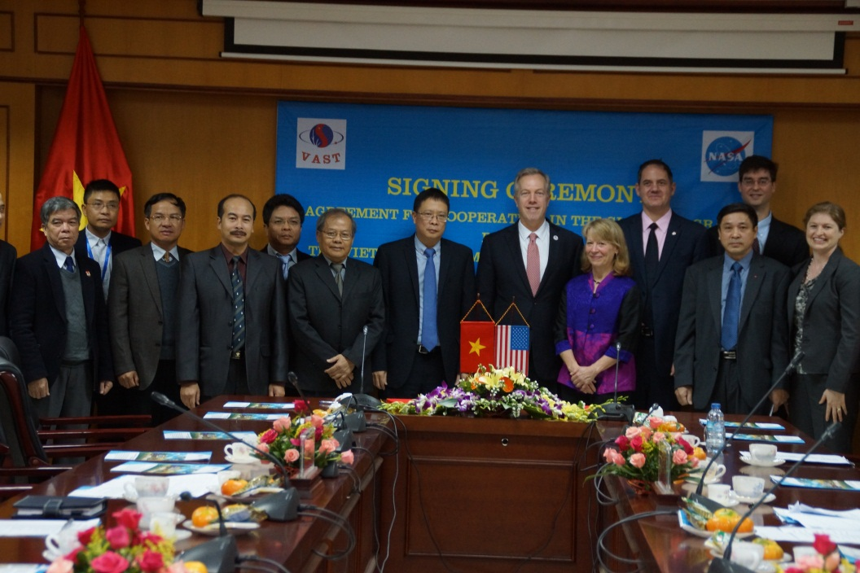
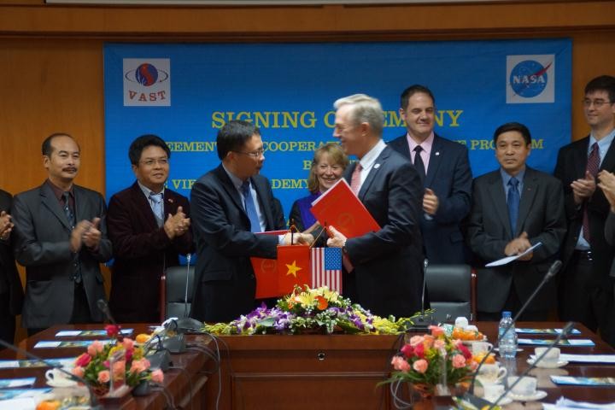
Back ground information
VAST and NASA signed Globe Agreement on Dec. 9, 2015
VAST appointed VNSC to implement GLOBE in Vietnam

Slide 5
Back ground information
Make a 3-years plan for Vietnam in cooperation with Ministry of Science and Technology and Ministry of Education and Training (in accordance with Regional 3-years plan)
2016: Implement a pilot program in Hanoi
- Select school for pilot program
- Organizing workshops to introduce Globe program
- Train the trainers
- Implement activities
2017: Evaluation pilot program and officially run the Program in Hanoi
2018: Officially run the Program in Ho Chi Minh City
2018: May – the Globe Regional Meeting at Hanoi
2018-2019: Zika activities

Slide 6
Back ground information
Globe Program
Ministry of Training and Education
Regional Globe
VNSC
CED
Schools
Country Globe

Slide 7
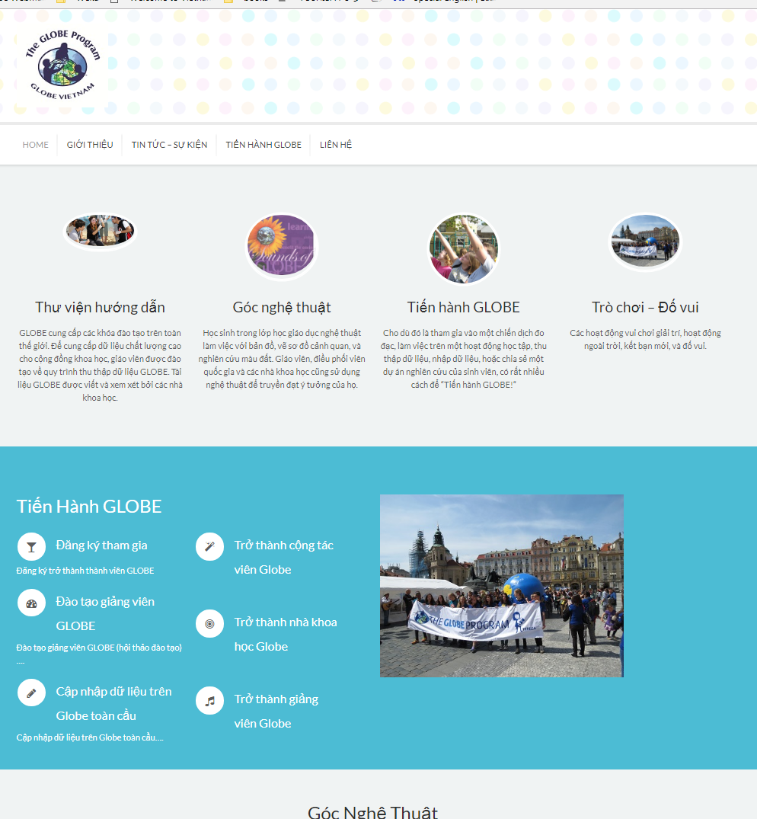
Back ground information
http://globe.vn/
Facebook Globe Vietnam
You can find:
Documents
Guide
To be Globe member

Slide 8
Back ground information
Participating schools:
34 schools, and 20 organizations
Funding by:
VNSC: VNSC: Vietnam National Space Center
GLOBE protocols used in country:
Atmosphere: Air Temperatures, Barometric Pressures, Cloud Observations, Relative Humidity
Hydrology: Mosquito Habitat Mapper
Number of schools currently reporting data (2018):
13 Schools
175 Observation

Slide 9
Activities in 2018 - 2019
Description of the program in your country and recent activities in 2018:
175 Observation
181 trainned teacher
06 trainning course of ZIKA (CMT) at Hà Nội, Ba Vì, An Giang, Tp. Hồ Chí Minh for 196 teachers
3 trainner for GLOBE Observer Mosquito.
2 GLOBE clubs, from: Experimental lower and upper secondary school and Nam Tu Liem Lower Secondary School involving to the student exchange program in Thailand from 19-23/08/2018
Continuously observation schools: Experimental lower and upper secondary school, Nam Tu Liem Lower Secondary School and Le Hong Phong gifted high shool
1 project used Globe data from Experimental lower and upper secondary school award gold medal at LAB 2018 (a science competition)

Slide 10
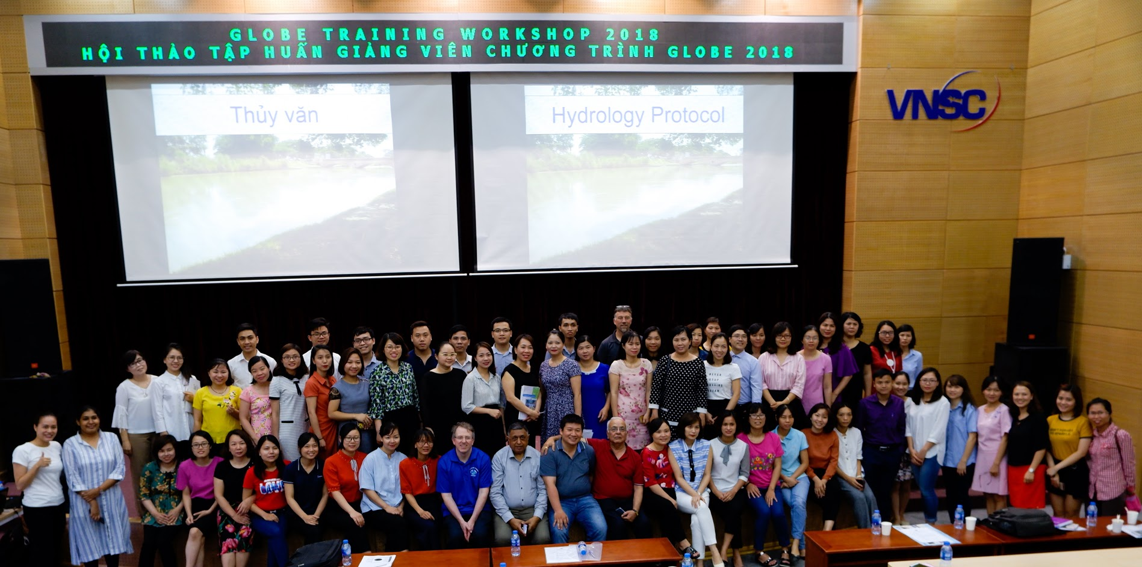
Activities in 2018 - 2019
Globe Training workshop 2018

Slide 11
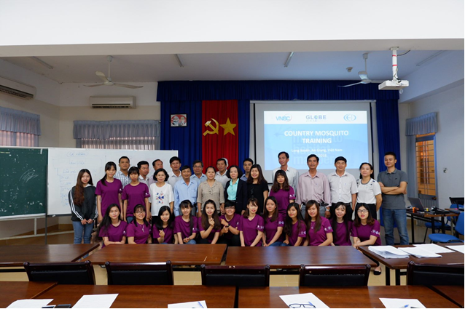
Activities in 2018 - 2019
Country mosquito training at An Giang province

Slide 12
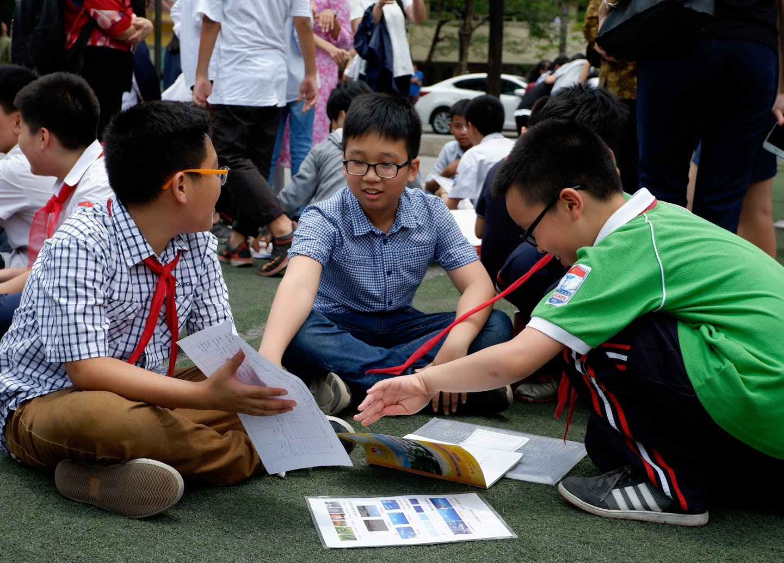
Activities in 2018 - 2019
Globe Activities at Experimental lower and upper secondary school

Slide 13
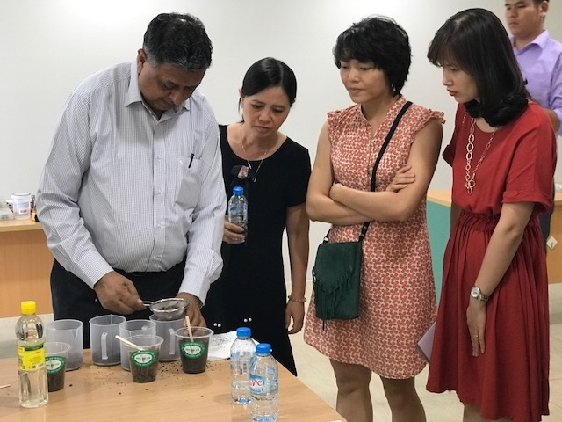
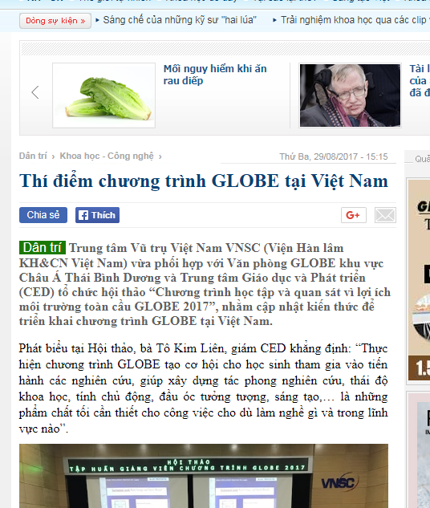
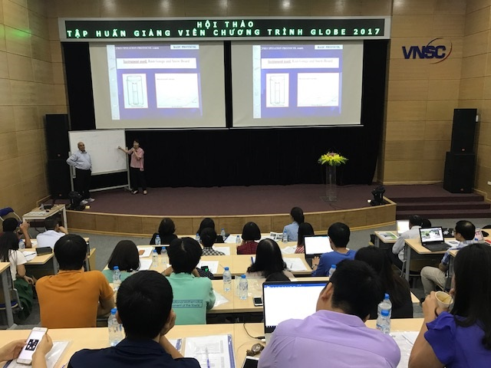
Activities in 2017 - 2019
Training

Slide 14
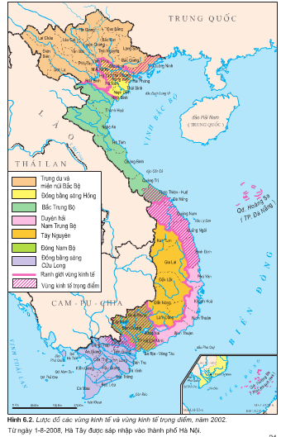
Activities in 2019-2020
Future activities
Training 2019: Ho Chi Minh city
More School involving (40)
More School active (15 -20)
More reports/ observation
Officially start at Ho Chi Minh city
Partly start at Nha Trang City
More protocols
To be official activity of secondary school in Vietnam
Further
Build up Globe community/ Globe network in Vietnam
Globe Vietnam meeting/ Globe day in Vietnam
Connect Globe activities with Educational activities at VNSC (museum, observatory, planetarium)

